Slide 1


Pediatric Minor Head Injury.
Dr. Toshimitzu Yue, Dr. Savithiri Ratnapalan

Slide 2
Disclosure
Relevant relationships with commercial entities:
None
Potential for conflicts of interest within this presentation:
None
Steps taken to review and mitigate potential bias:
N/A

Slide 3
Acknowledgements
Sincere gratitude and appreciation to the following individuals for their invaluable contributions in creating these slides:
Dr. Savithiri Ratnapalan
Dr. Alice Kam
Thank you all for your expertise, support, and guidance throughout the development of this presentation!

Slide 4

Case Study
Setting ED
Worried mother with a 10-year-old girl at for head injury.
While riding her scooter with her family she hit a bump flew over and hit her head.
She now complains of a bump on her forehead.

Slide 5
What do you want to know?
Discussion
Notes:
Can Skip if short on time straight to case.
Hx
Observed? Not observed? Injury?
Make sure! sometimes parents tell you the story from another person’s account (teacher/baby sitter).
Validity of HX to help you triage the case: is this ATLS protocol time?
If the child is verbal also include them in the Hx.
KEY Hx
Account of the event. MOI
Pain location
Neurological symptoms: seizure, weakness, sensory, visual change?
LOC?
PMH
Previous head injury?
Social Hx
Baseline functioning. Something to compare with.
This kid likes to vomit a lot from crying and stress.

Slide 6
The Case
14yo F with no significant past medical hx.
Stable vitals; GCS 15
HPI: 5 hours ago, hit the front of her head while scootering by breaking too hard.
  She was not wearing a helmet.
  NO change in GCS immediately after, no PTA.
  She had vomited 4 times.
Phx: Not irritable on examination and actively playing. O&A x3
  Minor hematoma and abrasion at the forehead and chin
  PERRLA, Full visual field, speech at baseline,
  No signs of basal skull fracture, no hemotympanum, no CSF otorrhea
Notes:
¥ Early signs of basilar skull fracture at presentation include hemotympanum, CSF rhinorrhea, and CSF otorrhea; late signs of basilar skull fracture, occurring up to 24 hours after injury, include raccoon eyes and post-auricular hematoma (Battle sign).

Slide 7


Minor head injury
Minor head injury is defined as injury within the past 24 hours
with one of the following:
• Witnessed loss of consciousness
• Definite amnesia
• Witnessed disorientation
• persistent vomiting (> 1 episode) or
• persistent irritability (< 2 years old)
• and a GCS score of 14–15
Notes:
Definition of minor head injury
GCS 9 to 13: Moderate head trauma
GCS ≤8: Severe head trauma

Slide 8
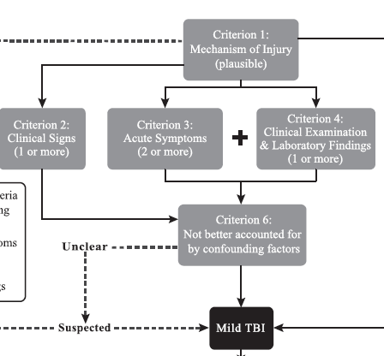
New MTBI Criterion
In short:
Injury to head+ Acute Signs of head injury (LOC/AMS)
Criterion 1+2
Or
Injury to head + 2 acute symptoms of concussion + 1 Clinical exam finding.
Criterion 1 + 3 +4
And
Always consider other causes (Criterion 6)
Noah et al., 2023

Slide 9
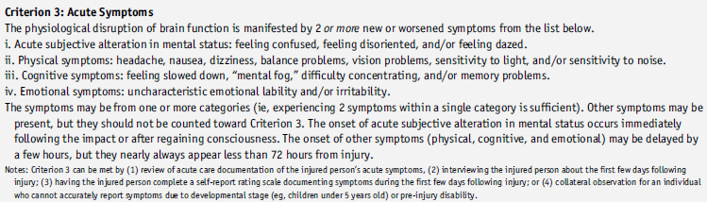
Symptoms of mTBI (criterion 3)

Slide 10
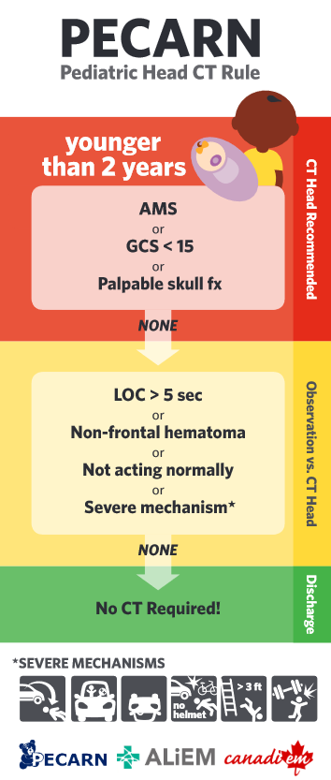
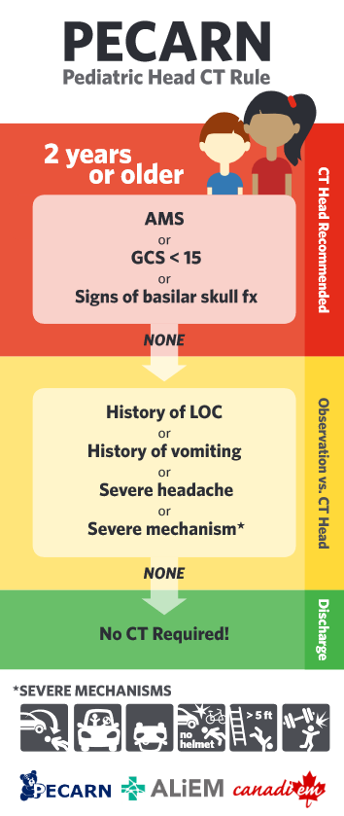
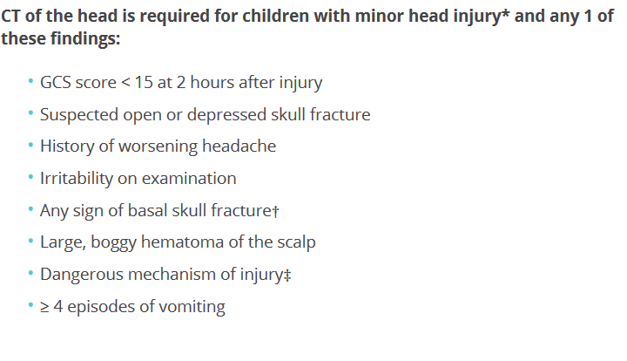
Key Hx and Phx?
Vs any incidence of headache
Not considered in PECARN
Vs any vomiting
Shonfeld et al., 2014
Lytte et al., 2012
Notes:
Recurrent vomiting
Isolated vomiting in the absence of other high-risk factors is
rarely associated with significant traumatic brain injury
(TBI). Recurrent vomiting (≥ 4 episodes, at least 15min
apart) is a significant risk factor for intracranial injury in children
after minor head injury. The addition of ≥ 4 episodes of vomiting
to CATCH2 increased sensitivity to 100% for neurosurgical
intervention and 99.5% for any brain abnormality.
Age and persistent irritability
Not acting normally as per parent or persistent irritability is
always a worrisome sign in a head-injured child under the age of
2 years. In a nonverbal child, assess whether the child can be
settled by their caregiver.
CT should be more strongly considered for children with multiple
findings, worsening symptoms or signs, and for infants younger
than 3 months of age – owing to their limited ability to
communicate and thinner skull
Isolated
LOC, headache, seizure not associated with intracranial abnormality.

Slide 11
The Yellow Zone
To CT or to Observe. Things that would push you towards CT.
1. The patient:
  Worsening symptoms? Catch2 vs PECARN
  Under age 3 months? It is difficult to assess non-verbal children.
  Irritable child?
2. The Mechanism:
  Use the mechanism outlined in PECARNS. It’s an example, not a complete list.
3. The context:
  Reliable parents. Parents can observe their child 4-6 hours at home.
  Access to health care. Do they have a family doctor?
Ultimately, you’ll need a Gestalt approach that should include shared decision-making with parents.
Isolated LOC, headache, and even seizure not associated with intracranial abnormality.
CATCH2 increased sensitivity to 100% for neurosurgical intervention and 99.5% for any brain abnormality.
Shonfeld et al., 2014 , Lytte et al., 2012
Notes:
Recurrent vomiting
Isolated vomiting in the absence of other high-risk factors is
rarely associated with significant traumatic brain injury
(TBI). Recurrent vomiting (≥ 4 episodes, at least 15min
apart) is a significant risk factor for intracranial injury in children
after minor head injury. The addition of ≥ 4 episodes of vomiting
to CATCH2 increased sensitivity to 100% for neurosurgical
intervention and 99.5% for any brain abnormality.
Age and persistent irritability
Not acting normally as per parent or persistent irritability is
always a worrisome sign in a head-injured child under the age of
2 years. In a nonverbal child, assess whether the child can be
settled by their caregiver.
CT should be more strongly considered for children with multiple
findings, worsening symptoms or signs, and for infants younger
than 3 months of age – owing to their limited ability to
communicate and thinner skull
Isolated
LOC, headache, seizure not associated with intracranial abnormality.

Slide 12
To PECARN or To CATCH2
POLL
Notes:
After seeing the difference? Does it matter?

Slide 13
CATCH 2 vs
PECARNS
Probability of Intracranial Pathology?
high probability/risk (low GCS at injury)
Low probability/risk use
CATCH2.
PECARNS
Helman et al., 2021
Notes:
Medcalc only has Catch not Catch2 just add the persistent vomiting part.
Pecarns Assumes all head injury should get a CT. if – you really don’t need the scan.
Catch 2 assumes no head injury should get a CT. If + then you really need it.
refined 8-item rule (CATCH2) with 100%
sensitivity for neurosurgical intervention and 99.5% sensitivity for
brain injury.

Slide 14
PECARN: Do not need CT
  Children <2 years: normal mental status, no scalp hematoma except frontal, no LOC or LOC<5 s, non-severe injury mechanism, no palpable skull fracture, & acting normally according to the parents
  Children = or >2 years and older: normal mental status, no LOC , no vomiting, non-severe injury mechanism, no signs of basilar skull fracture no severe headache
  Neither rule missed neurosurgery in validation populations.
42 412 , CT scans on 14 969 (35.3%); TBI in 376 (0.9%), Neurosurgery in 60 (0.1%)
Lancet. 2009;374:1160–70
Notes:
Medcalc only has Catch not Catch2 just add the persistent vomiting part.
Pecarns Assumes all head injury should get a CT. if – you really don’t need the scan.
Catch 2 assumes head injury should not get a CT. If + then you really need it.
refined 8-item rule (CATCH2) with 100%
sensitivity for neurosurgical intervention and 99.5% sensitivity for
brain injury.

Slide 15

To Discharge
Normal mental status with improving symptoms
Parental Preference
No risk factors indicating need for CT scan or normal CT (PECARNS/CATCH 22)
Notes:
So we did the CT Scan and didn’t find anything.
DO we discharge?
Consider parental experience and comfort.
Fortunately, only 5% of children with minor head injury will have
an intracranial abnormality on CT and about 1% will have a clinically
important outcome.
<14 years of age with
minor head trauma demonstrated that only 5% of children were
diagnosed with ICH more than 6 hours after the time of injury.
But balancing history (severity of injury/socioeconomic/parental comfort)
With CT.
PECARNS and CATCH2 is only a guideline.

Slide 16
Post Concussion Syndrome?
Defined as:
  trauma-induced brain dysfunction without demonstrable structural injury on standard neuroimaging.
  describes a symptom complex that includes headache, dizziness, neuropsychiatric symptoms, and cognitive impairment.
SYMPTOMS are vague.
Notes:
Ultimately, this child will likely have PCS: 30-80% of mTBI will have PCS

Slide 17
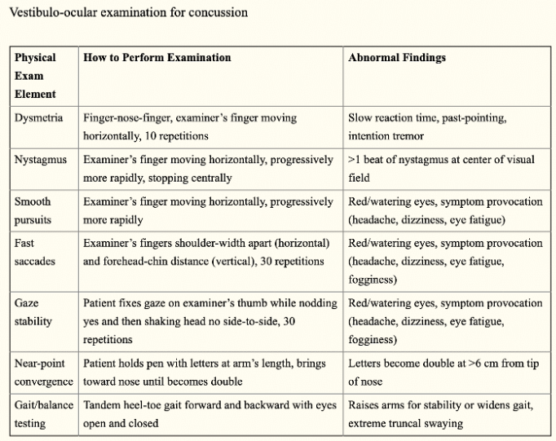
VOMS
Criterion 3
Mucha et al.., 2014
Notes:
VOMS exam can be broken down to
Eyes
Balance
Coordination
Good to have baseline.
Adults or children: especially for improvement.
But tandem stance is important we’ll discuss next slide.

Slide 18
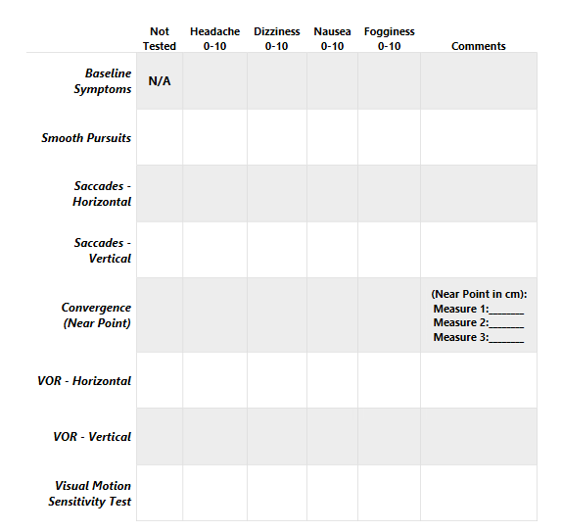
VOMS scoring.
Notes:
https://impacttest.com/wp-content/uploads/VOMS-Scorecard-and-Instructions.pdf
Tool to measure improvement.

Slide 19
5 P Score Calculator
 | 0 | 1 | 2
Age of patient | 5 to <8 years | 8 to <13 years | 13 to <18 years
Sex of patient | Male |  | Female
Does the patient have a headache? | No | Yes
Does the patient have sensitivity to noise? | No | Yes
Is the patient more fatigued? | No |  | Yes
On the BESS Tandem stance balance testing, how many errors did the patient have in 20 seconds? | 0-3 errors | 4 or more errors, or could not complete the balance testing
Did the patient answer questions more slowly than normal as compared to before the injury? | No | Yes
How long did the patient’s previous concussion last? | No previous concussion or recovery in less than 1 week | Recovery took 1 week or longer
Does the patient have a history of migraines? | No | Yes
Online score calculator: http://www.5pconcussion.com/en/scorecalculator Zemek et al., 2016
Notes:
BESS
Double leg stance with feet
Single leg stance
Tandem stance

Slide 20
Referral Recommendation
Screen completed
<48 hours from concussion injury >48 hours from injury
Score | Level of risk for prolonged symptoms | Referral Recommendations
0-3 | Low | 0-3 follow up with primary care
4-8 | Medium | 4-7 may consider referral for specialized care 7-8 immediate referral for specialized care
9-12 | High | 9-12 immediate referral to specialized care
Clinical risk scores are not an eligibly requirement for the early concussion care program.
A referral can be made for score <4 if the referring physician feels it is needed based on their clinical judgement or if there are any additional modifiers present

Slide 21
Discharge
Orders
24-48 hour rest.
Gradual Return!
High risk sports.
Sleep Hygiene, Adequate Hydration
Screen time
Thomas et al., 2015
Notes:
Important to note:
Resting leads to prolonged symptoms.
Activity is good.
Screen time: modern day our lives rotates around being from one screen to another.
Depression rates, isolation, by avoiding social networking apps. (ironically)
Reduce unneeded screen time. Not human connection.
Side note. ADHD, depression mediation on the length of symptoms? No clear systematic review but continue medication.
50% of ppl with PCS will develop a psychological symptoms

Slide 22
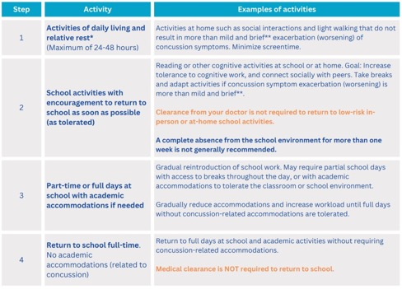
Return to School Strategy
Adapted from: Patricios et al. (2023). Consensus statement on concussion in sport: the 6th International Conference on Concussion in Sport–Amsterdam, October 2022. British Journal of Sports Medicine,57,695-711.
Notes:
https://parachute.ca/wp-content/uploads/2019/06/Pan-Canadian-Harmonized-School-Concussion-Protocol-Template.pdf
Quick slide:
Stage 1 2 is home. Cognitive rehab vs rest.
Stage 3 4 is school.
Side note: we’ll discuss more about what patients/parents should consider increased symptoms or normal symptom.

Slide 23
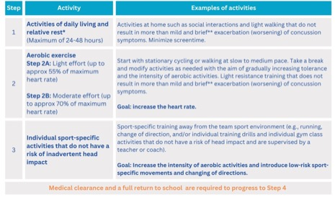
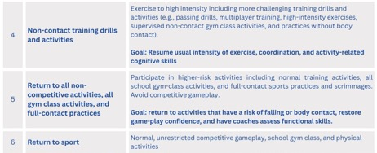
Return to Sports Strategy
Adapted from: Patricios et al. (2023). Consensus statement on concussion in sport: the 6th International Conference on Concussion in Sport–Amsterdam, October 2022. British Journal of Sports Medicine,57,695-711.
Notes:
Each stage is a minimum of 24 hours.
Depending on the severity and type of symptoms present, students will progress through the
following stages at different rates. Individual catering.
Return to sports even for those not playing competitively
Cardio = increased cerebral perfusion… Theoretically
This should occur in parallel with return to school.
It is important that students return to full-­‐time school activities
before progressing to stage 5 and 6 of the Return-­‐to-­‐ Sport Strategy
FM
STEP 5 medical clearance means SUPERVISED (coach/teacher/parents)

Slide 24
Reference
Silverberg, N. D., Iverson, G. L., Group, A. B. I. S. I., Cogan, A., Dams-O-Connor, K., Delmonico, R., ... & Zemek, R. (2023). The American Congress of rehabilitation medicine diagnostic criteria for mild traumatic brain injury. Archives of physical medicine and rehabilitation, 104(8), 1343-1355.
Schonfeld, D., Bressan, S., Da Dalt, L., Henien, M. N., Winnett, J. A., & Nigrovic, L. E. (2014). Pediatric Emergency Care Applied Research Network head injury clinical prediction rules are reliable in practice. Archives of disease in childhood, 99(5), 427-431.
Lyttle, M. D., Crowe, L., Oakley, E., Dunning, J., & Babl, F. E. (2012). Comparing CATCH, CHALICE and PECARN clinical decision rules for paediatric head injuries. Emergency Medicine Journal, 29(10), 785-794
Helman, A. (2022, Oct 6). Pediatric minor head injury and concussion. Emergency Medicine Cases. https://emergencymedicinecases.com/pediatric-minor-head-injury-concussion/
Mucha, A., Collins, M. W., Elbin, R. J., Furman, J. M., Troutman-Enseki, C., DeWolf, R. M., ... & Kontos, A. P. (2014). A brief vestibular/ocular motor screening (VOMS) assessment to evaluate concussions: preliminary findings. The American journal of sports medicine, 42(10), 2479-2486.
Zemek, R., Barrowman, N., Freedman, S. B., Gravel, J., Gagnon, I., McGahern, C., ... & Pediatric Emergency Research Canada (PERC) Concussion Team. (2016). Clinical risk score for persistent
Thomas, D. G., Apps, J. N., Hoffmann, R. G., McCrea, M., & Hammeke, T. (2015). Benefits of strict rest after acute concussion: a randomized controlled trial. Pediatrics, 135(2), 213-223.
Patricios, J., Schneider, K., Dvorak, J., Ahmed, o.,Blauwet, C., Cantu, R., ... & Meeumisse, W. (2023). Consensus statement on concussion in sport: the 6th International Conference on Concussion in Sport–Amsterdam, October 2022. British Journal of Sports Medicine,57,695-711.

