Slide 1
Geriatric Concussions in the Acute Setting
Presenter: Dr. Claire Fine PGY1, FM
Small Group Facilitator: Dr. Husain, MD, CCFP, FCFP

Slide 2
Disclosures
Relevant relationships with commercial entities:
None
Potential for conflicts of interest within this presentation:
None
Steps taken to review and mitigate potential bias:
N/A

Slide 3
Acknowledgements
I would like to express my heartfelt gratitude and appreciation to the following individuals for their invaluable contributions in creating these slides:
Dr. Kam, MD, FRCPC, Physical Medicine and Rehabilitation, for teaching me the concussion curriculum and for presentation contributions and edits
Dr. Husain, MD, CCFP, for facilitating the small group session and for presentation contributions and edits
Dr. Tartaglia, MD., FRCPC, Neurology, for contributions to migraine management
Ching-Lung Huang, for assistance and organizational support in creating this presentation

Slide 4

The case of Ms. M
An 81-year-old female was carrying groceries to her car, when she slipped on ice, hit the back of her head and lost consciousness for 10 seconds. Her friend called EMS and she was brought to the ER. She had a CT head which was negative and was discharged with the diagnosis of concussion. You are seeing her for follow up 3 days later.
Her main symptoms are headache and dizziness. Her headache is worse with noise and bright light. It is frontal and throbbing. The dizziness is intermittent, worse with head movements and there is some mild associated nausea
Past Medical History: Osteoporosis, anxiety, hypothyroidism, 2x history of concussions 3 and 10 years ago, PUD, DLD, HTN
Medications: Sertraline 50mg OD, Synthroid 80mcg/day, Crestor 20mg, Perindopril 5mg

Slide 5
Differential Diagnosis - Headache

Slide 6
Differential Diagnosis - Headache
Migraine
Tension
TMJ
Medication Overuse
Occipital Neuralgia
Intracranial hemorrhage
Skull fracture
Whiplash
Cervicogenic

Slide 7
Assessment and Management of Post Traumatic Headache Following mTBI

Slide 8
1) Focused History

Slide 9
1) Focused History
Headache Hx:
O-P-Q-R-S-T
Associated symptoms (e.g., nausea/vomiting)
Previous treatments
Hx of Concussion, Head, Face, Cervical Spine Trauma:
Mechanism, subsequent symptoms, loss of consciousness, treatments, recovery timeline
Functional Hx:
Degree of disability and medication consumption
IADLs, ADLs, exercise, driving, gait aids, supports at home
Baseline, pre-mTBI symptoms (nausea, balance, dizziness, vision, etc)
  Many symptoms of concussion are concomitant with aging which complicates differentiating new symptoms from preexisting pathology

Slide 10
Diagnostic Challenges in Older Adults
(McCulloch, Osborne and Ramsey, 2020)

Slide 11
Diagnostic Challenges in Older Adults
Common mTBI signs and symptoms | Challenge of identification in older adults
Balance and gait disturbances | -Many comorbidities associated with gait and balance disorders (Parkinson’s, stroke, sensory abnormalities, PAD, orthostatic hypotension, etc.)
Headache | -20% of patients > 70 years old have complaints of neck pain without trauma -High prevalence of untreated HTN in older adults
Nausea/vomiting | -High prevalence of GERD, or medications causing nausea
Depression | -Comorbidities common in older adults are associated with depression (e.g., Parkinson’s disease)
Blurry vision | -Difficulty for differentiation of blurry vision secondary to age-related changes such as macular degeneration
(McCulloch, Osborne and Ramsey, 2020)

Slide 12
Ms. M’s History
Her headache is frontal and bilateral. She describes the pain as throbbing, constant and 7/10 in severity. “I cannot function with this headache”. She has photophobia. There is mild nausea, no vomiting. There is no phonophobia. She has tried taking Ibuprofen 400 mg q4-6 hours and Acetaminophen 500mg q4-6 hours with minimal relief. The pain is only relieved by sleep. She has intermittent dizziness that comes on with head movements.
She usually mobilizes with a 2 wheeled walker. She is dependent on support for her IADLS. She is mostly independent for her ADLs but has PSW support 3 times per week for help with bathing. She lives with her daughter, son in law and 2 grandkids. She enjoys reading, watching the news and going to the park with her grandkids.

Slide 13
Headache type?

Slide 14
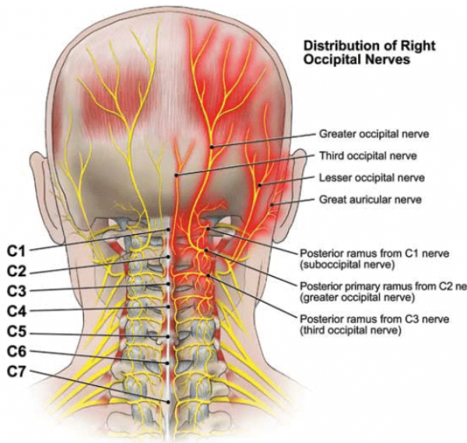
2) Determine type of headache presentation
Migraine:
  Unilateral, lasting 4-72 hours, pulsating quality, moderate-severe intensity, aggravated with routine physical activity, associated with nausea, photophobia, phonophobia
Tension:
  Bilateral, pressing or tightening (non-pulsating) quality, mild-moderate intensity, not aggravated by routine physical activity
Medication-Overuse Headache
  Occurring on ≥15 days per month in a patient with a pre-existing headache disorder with regular use >3 months of medication for acute symptoms
Occipital Neuralgia
  Sudden-onset shooting or stabbing pain in the posterior skull, in the distribution of the occipital nerves, +/- dyasthesia, tender over involved nerve
https://www.facepain.org/understanding-facial-pain/diagnosis/occipital-neuralgia/

Slide 15
3) Physical Exam

Slide 16
3) Physical Exam
Vitals, orthostatic vitals
General appearance, inspection of head and neck, gait
Cervical spine:
Range of motion
Focal areas of tenderness
Hypertonicity
TMJ:
Range of opening
Tenderness
Dislocation
Neuro:
Cranial nerve exam
Reflexes
Romberg
Cerebellar tests
Vision:
Acuity
Tracking
Saccades
Visual fields
Sensory:
Sharp and light touch
Motor:
Power
Coordination
Vestibular:
HINTS
Dix-Hallpike

Slide 17
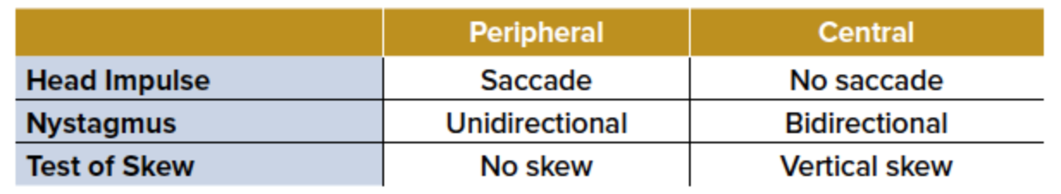
3) Physical Exam - HINTS Exam
(Simpson and Kalivoda, 2019)

Slide 18
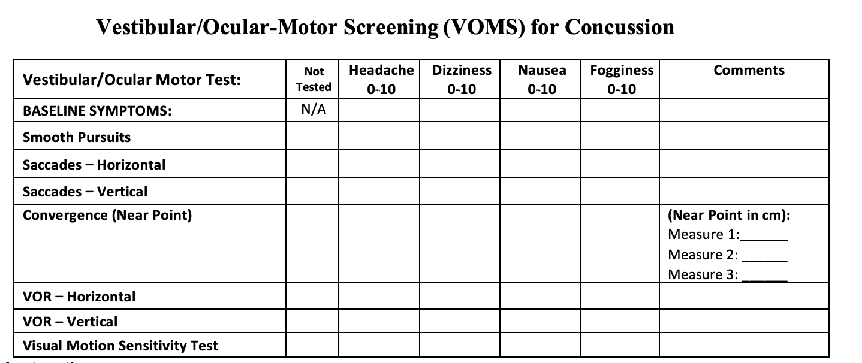
3) Physical Exam - VOMS
(Elder et al., 2016)
Baseline symptoms assessed
Patient rates symptoms on 0 – 10 scale for each test
  Note: normal convergence is <6cm

Slide 19
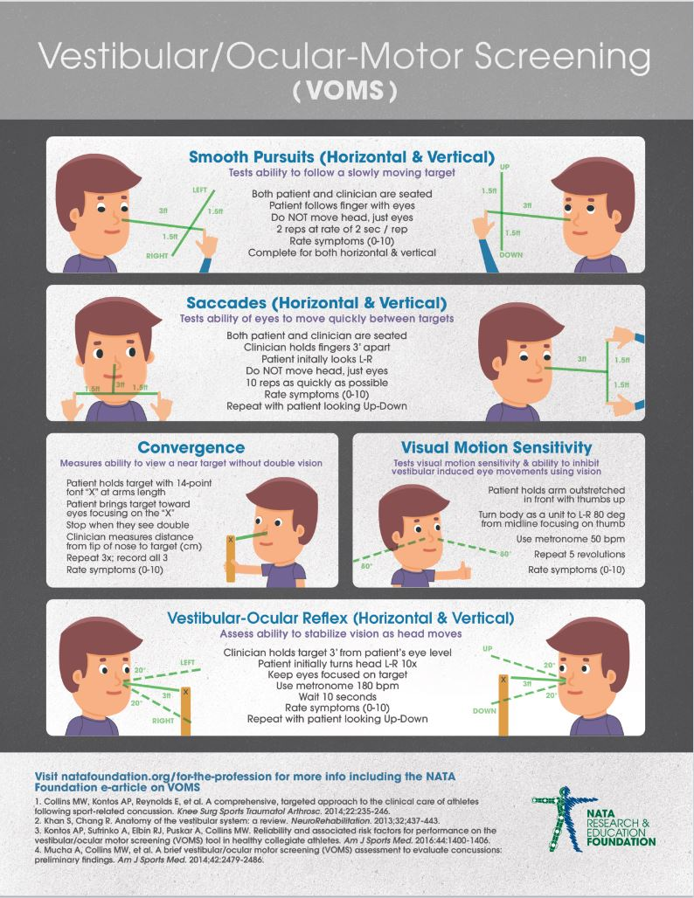
Smooth Pursuits — The ability of the eyes to slowly follow an object along a pathway with the head remaining in place.
Saccades — The ability of the eyes to move quickly from one object to another while staying in focus.
Convergence — The ability to view a near target without double vision.
Vestibular-Ocular Reflex (VOR) — The ability to maintain eyes and fixation on an object while the head is moving.
(DiCesaro and Kingma, 2017)

Slide 20
3) Physical Exam - VOMS for Ms. M
6
2
2
6
7
4
2
6
7
5
2
7
7
4
2
6
4 cm
4 cm
4.5 cm
9
5
3
9
8
4
4
8
8
3
2
7
(Elder et al., 2016)

Slide 21
How do we interpret Ms. M’s VOMS result?

Slide 22
VOMS Clinical Implications
NOT required to make diagnosis of mTBI
Positive result can be used to provide supportive evidence of mTBI
  Symptom difference ≥ 2 has been shown to be associated with concussion (Elbin et al., 2019)
Potentially can be used to monitor recovery
Research has indicated abnormal findings or provocation of symptoms after a test may indicate vestibular ocular impairment (Parrington et al., 2022)
  Consider referral to vestibular rehab
Not a stand-alone prognostic tool, but may help to identify those that will have a delayed recovery (Petit et al., 2019)

Slide 23
Other Risk Factors for Prolonged Recovery in Ms. M

Slide 24
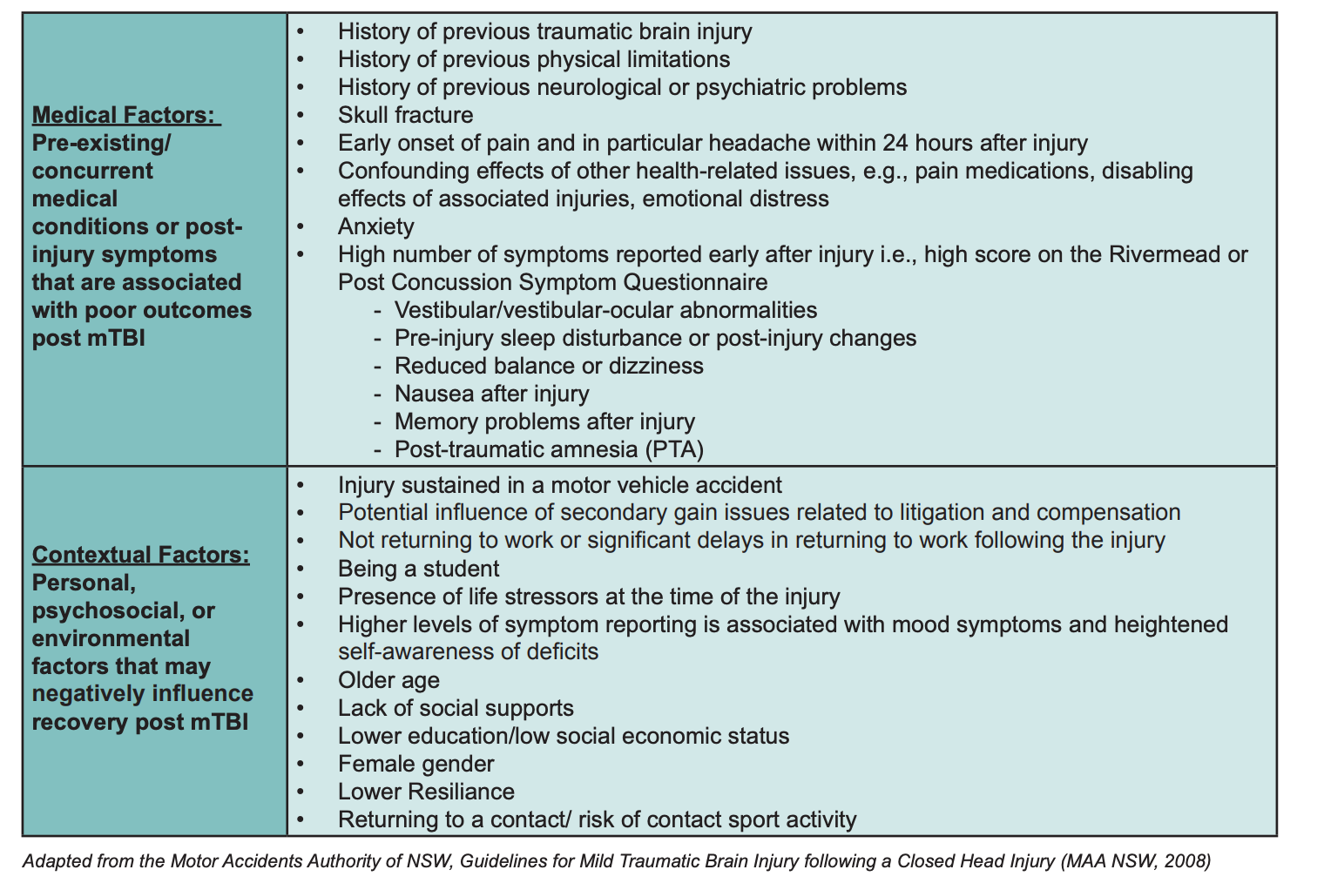
Other Risk Factors for Prolonged Recovery in Ms. M
✓
✓
✓
✓
✓
✓
✓

Slide 25
Headache Management - Migrainous Type
Lifestyle factors:
  Sleep - encourage sleeping and waking up at same time
  Diet - protein with every meal, eat within 60 minutes of waking up, avoid high sugar content
  Hydration
  Limit screen time 30 minutes before sleeping
  Exercise
Vitamin/minerals:
  Magnesium Citrate 400-600mg
  Vitamin B2 - 400mg/day
  Vitamin D3 - 1000mg BID
  Coenzyme Q10 - 100mg TID

Slide 26
Pharmacotherapy - Migrainous Type
Abortive therapy:
  NSAIDs
  Triptans:
    Sumatriptan 50-100mg po
    Rizatriptan 10mg po
    Eletriptan 80mg po
Prophylaxis:
  Gabapentin 300-800 mg TID
  Beta blockers:
    Propranolol 20-240 mg BID (can titrate up to 240mg daily)
    Metoprolol 25-200 mg
  Venlafaxine 37.5-150 mg OD
  Amitriptyline 10-50 mg QHS
    Sedating and anticholinergic effects - use cautiously in older adults, avoid in elderly or patients with cognitive impairment
  Topiramate 25-100mg OD

Slide 27
Headache Management - Tension Type
Acute:
  NSAIDs
  Aspirin
  Tylenol
  NSAIDs + caffeine
Chronic (≥15 headache days a month):
  Amitriptyline 10-125 mg QHS
  Venlafaxine 37.5-150 mg OD
  Topiramate 25-100 mg OD
  Tizanidine 2-18 mg OD
  Trigger point injections, Botulinum toxin injections

Slide 28
Special Considerations for Ms. M
Smart Prescribing
  Avoid anticholinergics, alpha blockers, sedatives, NSAIDs and ASA given PUD hx
May need input from family members/support systems
Expect extended recovery time
May be difficult to differentiate between baseline symptoms vs mTBI symptoms
Decline in function in vestibular system with age due to hair cell loss and otolith degeneration

Slide 29
Returning to Daily Activity

Slide 30
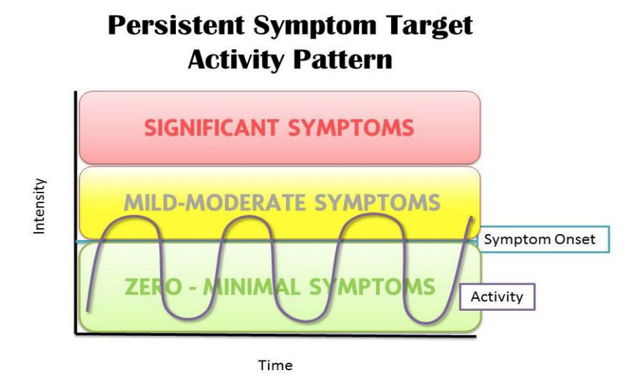
Returning to Daily Activity
Brief period of rest during the acute phase (24-48 hrs)
Goal: Gradually increase activity tolerance without significantly increasing symptoms
Counsel patients that transient symptom exacerbations with increased activity are common
Can recommend short bouts of exercise/activity or switching between different types of activity (i.e. from reading to walking)
(Ontario Neurotrauma Foundation, 2018)

Slide 31
Counseling Ms. M
Relative rest for the first 1-3 days
Set expectations, define restrictions and limitations:
“The concussion will make certain tasks harder to do”
“You do not need to be symptom-free to return to daily activities”
“If symptoms worsen substantially with a new or more intense activity, try stepping the activity back to a lower level”
Describe gradual return to activities and explain the threshold approach:
Start reading, texting or screen time 5-15 minutes at a time. If symptoms are stable, can increase length of time
If symptoms do not worsen, increase length of activity the next day
Start with a five minute walk and if tolerating, increase each day by 5 minutes in length

Slide 32
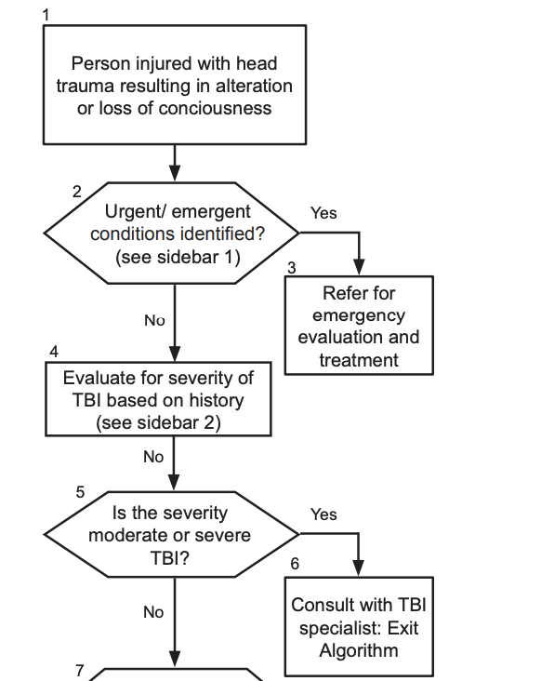
When to refer?
-
(Ontario Neurotrauma Foundation, 2018)

Slide 33
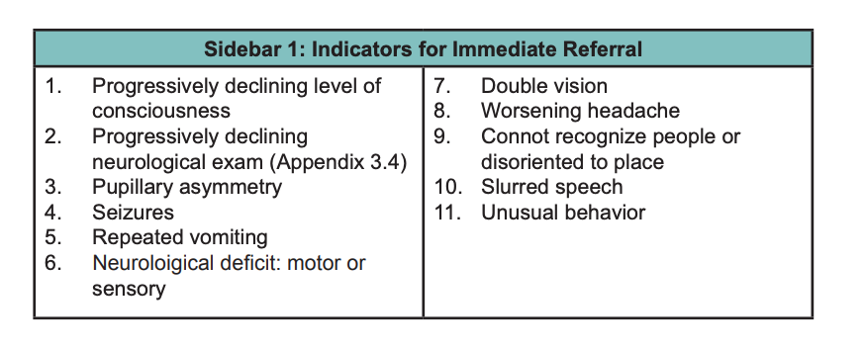
When to refer?
(Ontario Neurotrauma Foundation, 2018)

Slide 34
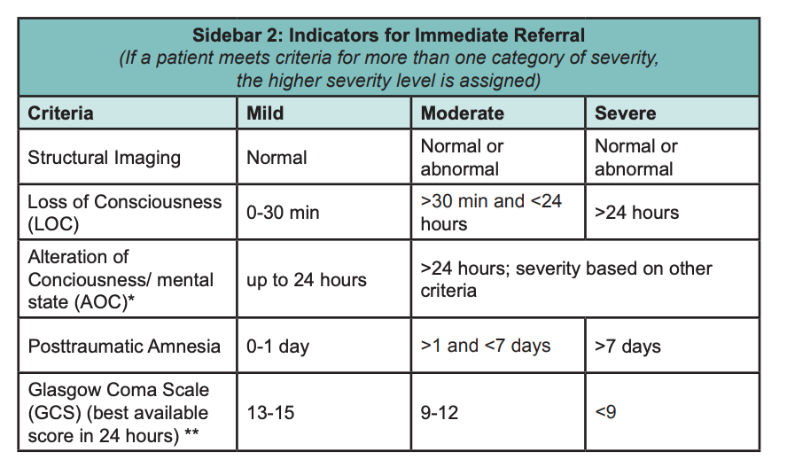
(Ontario Neurotrauma Foundation, 2018)

Slide 35
References
Dicesario S.F. and Kingma J. (2017). Vestibular-Ocular Motor Screening (VOMS). Nata Research & Education Foundation. https://www.natafoundation.org/wp-content/uploads/VOMS-DiCesaro-Kingma-Submission-4-2017-1.pdf.
Elbin, R. J., Sufrinko, A., Anderson, M. N., Mohler, S., Schatz, P., Covassin, T., Mucha, A., Collins, M. W., & Kontos, A. P. (2018). Prospective Changes in Vestibular and Ocular Motor Impairment After Concussion. Journal of neurologic physical therapy : JNPT, 42(3), 142–148. https://doi.org/10.1097/NPT.0000000000000230
Elder et al. (2016). Concussion Update: Vestibular/Ocular Motor Eval +Rehab // Other Updates. Foundation for Orthopaedic Research and Education. https://foreonline.org/wp-content/uploads/2016/07/18.-Elder-Concussion-Update-KE.pdf
Gardner, R. C., Dams-O'Connor, K., Morrissey, M. R., & Manley, G. T. (2018). Geriatric Traumatic Brain Injury: Epidemiology, Outcomes, Knowledge Gaps, and Future Directions. Journal of neurotrauma, 35(7), 889–906. https://doi.org/10.1089/neu.2017.5371
Heslot, C., Azouvi, P., Perdrieau, V., Granger, A., Lefèvre-Dognin, C., & Cogné, M. (2022). A Systematic Review of Treatments of Post-Concussion Symptoms. Journal of clinical medicine, 11(20), 6224. https://doi.org/10.3390/jcm11206224
Mcculloch, Karen & Osborne, Mary & Ramsey, Crystal. (2020). Geriatric Mild Traumatic Brain Injury (mTBI). Current Geriatrics Reports. 9. 10.1007/s13670-020-00329-3.
Mucha, A., Collins, M. W., Elbin, R. J., Furman, J. M., Troutman-Enseki, C., DeWolf, R. M., Marchetti, G., & Kontos, A. P. (2014). A Brief Vestibular/Ocular Motor Screening (VOMS) assessment to evaluate concussions: preliminary findings. The American journal of sports medicine, 42(10), 2479–2486. https://doi.org/10.1177/0363546514543775

Slide 36
References Continued
Ontario Neurotrauma Foundation. (2018). Guideline for Concussion/Mild Traumatic Brain Injury & Prolonged Symptoms. https://braininjuryguidelines.org/concussion/fileadmin/pdf/Concussion_guideline_3rd_edition_final.pdf
Parrington, L., King, L. A., Hoppes, C. W., Klaiman, M. J., Michielutti, P., Fino, P. C., Dibble, L. E., Lester, M. E., & Weightman, M. M. (2022). Exploring Vestibular Ocular Motor Screening in Adults With Persistent Complaints After Mild Traumatic Brain Injury. The Journal of head trauma rehabilitation, 37(5), E346–E354. https://doi.org/10.1097/HTR.0000000000000762
Silverberg, N.D. (2020). Management of concussion and mild traumatic brain injury: a synthesis of practice guidelines. Archives of Physical Medicine and Rehabilitation., 101(2). https://doi.org/10.1016/j.apmr.2019.10.179
Simpson, M.D., & Kalivoda, E. (2019). Neurology: Take a HINT on Central Vertigo in the Emergency Department. EM Resident. https://www.emra.org/emresident/article/hints-exam
Thomas CE, Thomas SH, Bloom B. (2023). Vestibular/ocular motor screening (VOMS) score for identification of concussion in cases of non-severe head injury: A systematic review. Journal of Concussion. 7. doi:10.1177/20597002231160941
Whitney, S. L., Eagle, S. R., Marchetti, G., Mucha, A., Collins, M. W., Kontos, A. P., & CARE Consortium Investigators (2020). Association of acute vestibular/ocular motor screening scores to prolonged recovery in collegiate athletes following sport-related concussion. Brain injury, 34(6), 840–845. https://doi.org/10.1080/02699052.2020.1755055

